Slide 1

ROBUST STATISTICS IN
PORTFOLIO CONSTRUCTION
R. Douglas Martin
Professor of Applied Mathematics & Statistics
Director of Computational Finance Program
University of Washington
doug@amath.washington.edu
Parts of R-Finance Conference 2012 Tutorial
for
R-Finance 2013 Chicago, May 17-18

Slide 2
1. Why robust statistics in finance?
R robust library
Robust factor models
Robust volatility clustering models
Robust covariance & correlation
  - Next talk
Appendix: Robustness concepts & theory

Slide 3

1. WHY ROBUST STATS IN FINANCE?
All classical estimates are vulnerable to extreme distortion by outliers, and financial data has outliers to various degrees. You need robust estimates that are:
Not much influenced by outliers
Good model fit to bulk of the data
Reliable returns outlier detection
Stable inference and prediction

Slide 4
Important Points
Myth: Robust statistical methods throw away what may be the most important data values
  Model fit is only the first step in the analysis, and robust statistics reliably detects outliers that are often completely missed with classical estimates. Then can check if they are important or just noise.
Do not use blindly in risk applications
  Outlier rejection can give misleading optimism about risk. But they can sometimes lead to pessimism.

Slide 5
2. R PACKAGE robust
John Tukey (1979): “… just which robust methods you use is not important – what is important is that you use some. It is perfectly proper to use both classical and robust methods routinely, and only worry when they differ enough to matter. But when they differ, you should think hard.”
Robust Library Motivation: Make it possible for everyone to easily compute classical and robust estimates!
Cavet : It is important which robust method you use! Some are much better than others.

Slide 6
R Package robust
Originally created by Insightful under an NIH SBIR grant, with Doug Martin as P.I., Kjell Konis (primary) and Jeff Wang as developers. Given over to R by Insightful with Kjell Konis as maintainer. The CRAN site shows:
Author: | Jiahui Wang, Ruben Zamar, Alfio Marazzi, Victor Yohai, Matias Salibian-Barrera, Ricardo Maronna, Eric Zivot, David Rocke, Doug Martin, Martin Maechler, Kjell Konis.
Maintainer: | Kjell Konis kjellk@uw.edu
There is also the R package robustbase, with a lot of people working on it. Kjell has a goal of putting as many of the “robust” library methods (current and future) into “robustbase” as he can manage.

Slide 7
3. ROBUST FACTOR MODELS
Better betas
Robust asset pricing models
More representative covariance matrix for MV portfolio optimization, directly or via a factor model
More representative decomposition of risk into factor risk and specific risk

Slide 8
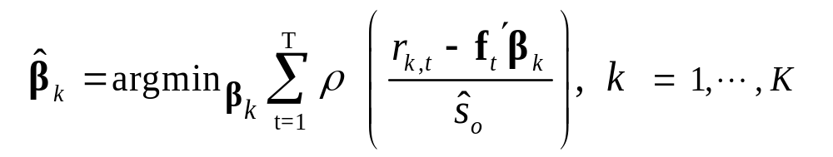
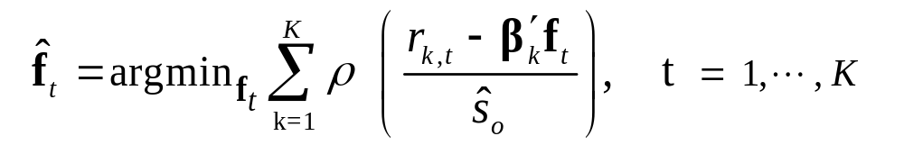

Optimal Bias Robust M-Estimates
Time Series Factor Models for FoF’s (factor returns known)
Fundamental Factor Models (exposures/betas known)
must be bounded hence non-convex for robustness,
which requires sophisticated optimization.

Slide 9


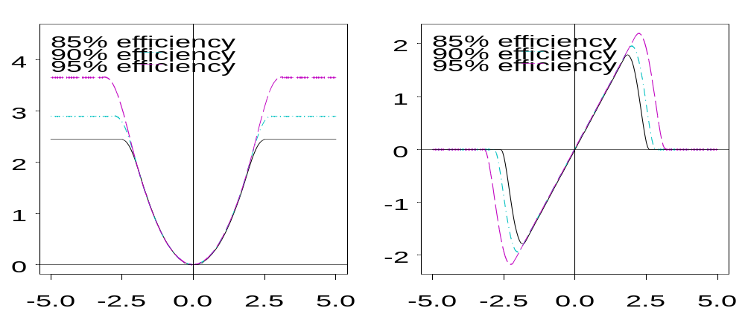
Optimal* Rho and Psi
*Minimizes maximum bias due to outliers with only somewhat higher variance OLS when returns are normally distributed. See Yohai and Zamar (1997), Svarc, Yohai and Zamar (2002).

Slide 10
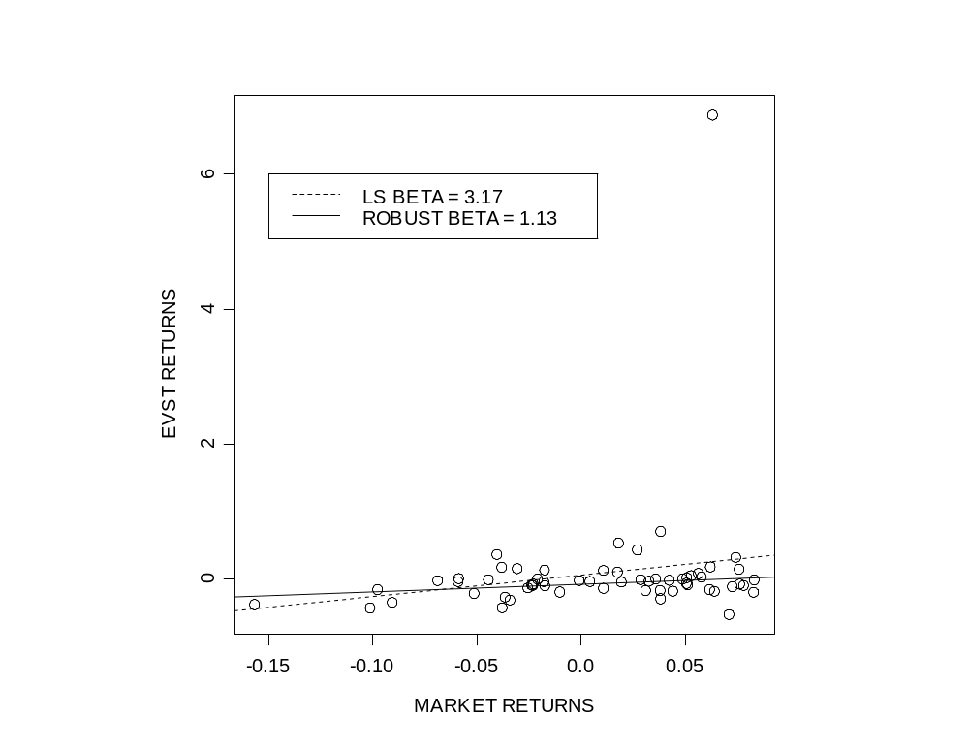

Robust vs LS Betas
Outlier
CLASSICAL BETA = 3.17
This is what you get today:
a very misleading result, caused by one outlier, and predicts future betas poorly!
ROBUST BETA = 1.13
Fits bulk of data to accurately describe the typical risk and return, and predicts future betas.
See Martin and Simin (2003), Financial Analysts Journal

Slide 11
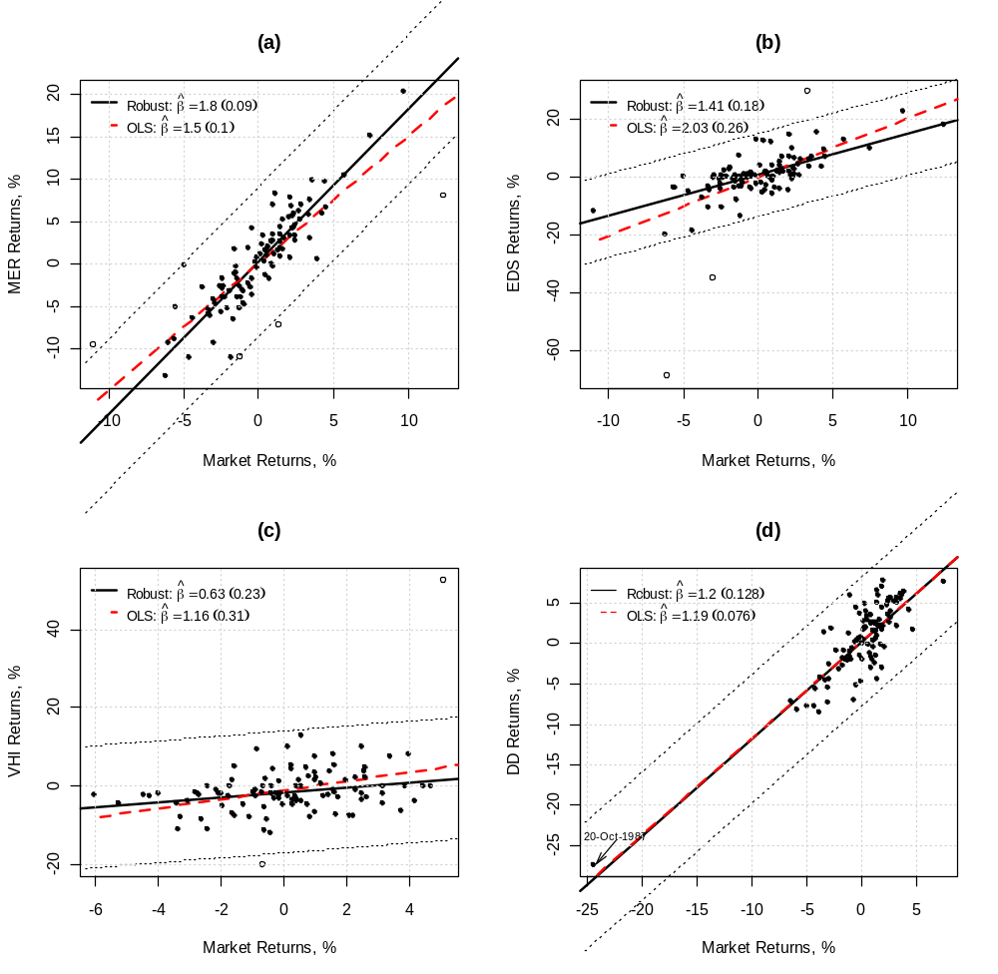
Robust vs. LS Market Models*
* Bailer, Maravina and Martin (2012)

Slide 12
Robust Regression of Returns vs. Size
Fama and French (1992) results: equity returns are negatively related to firm size when using LS
Knez and Ready (1997) results: returns are positively related to size for the vast majority of the data when using LTS regression
  Positive relationship is rather constant for all trimming between 50% and 5%, and the relationship remains positive even at 1% trimming. Furthermore there is little loss of efficiency in the 1% to 5% trimming range

Slide 13
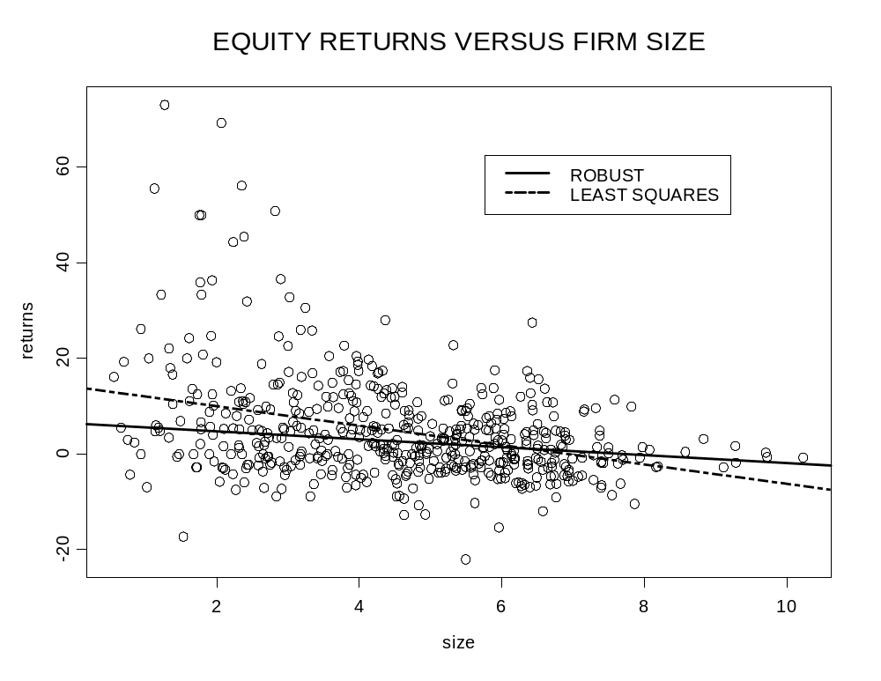
Monthly Returns July 1963

Slide 14
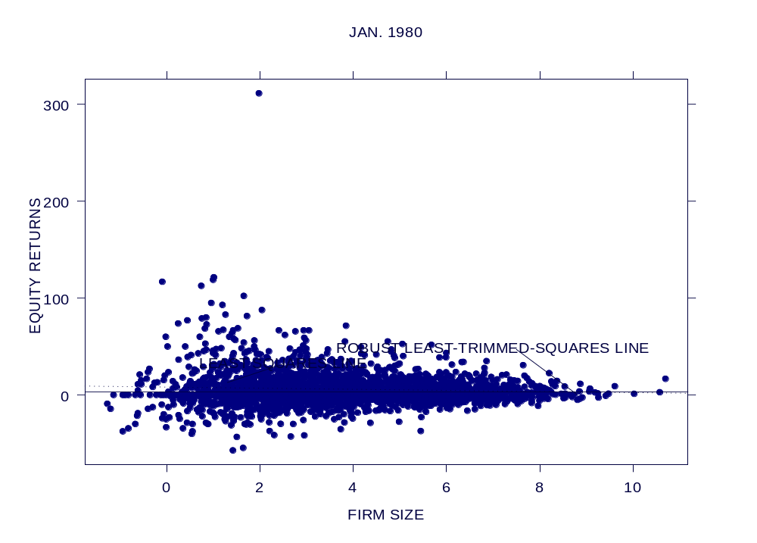
Monthly Returns January 1980

Slide 15
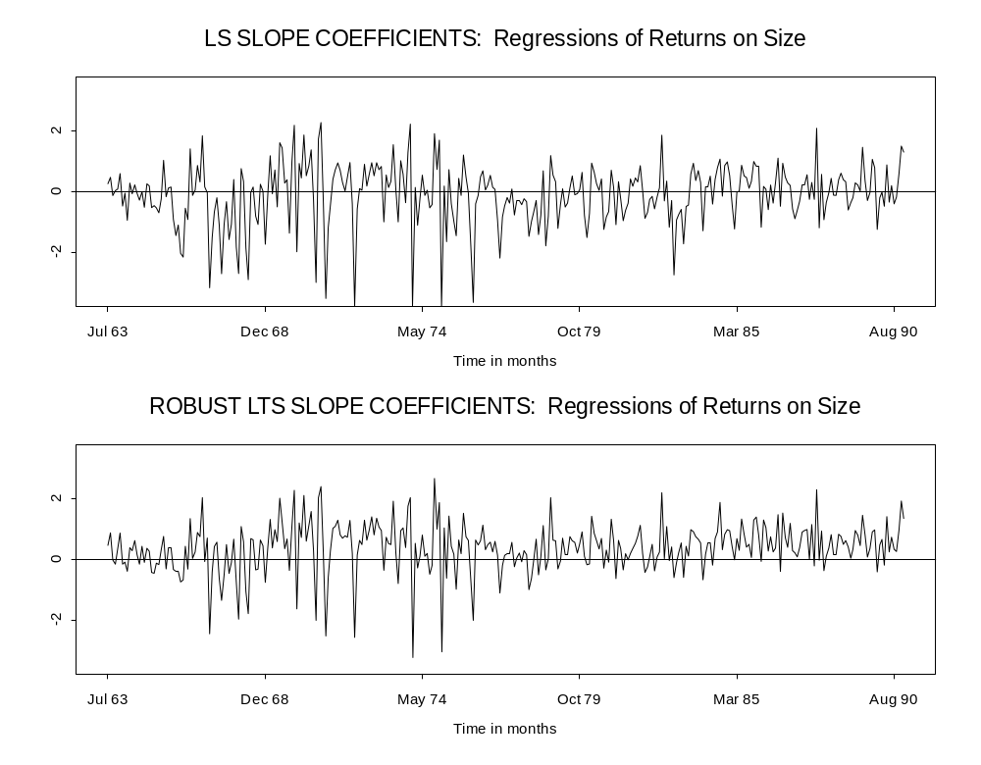
Time Series of Slope Coefficients
Fama-French:
t-statistic indicates
negative relation
Knez-Ready:
t-statistic indicates
positive relation
(for vast majority
of firms)!

Slide 16

Robust Fundamental Factor Models
R package now in “factorAnalytics”, originally created by Chris Green and others, with Doug Martin, and ported to R by Guy Yollin. Likely to see further development
Example of use in next slides

Slide 17
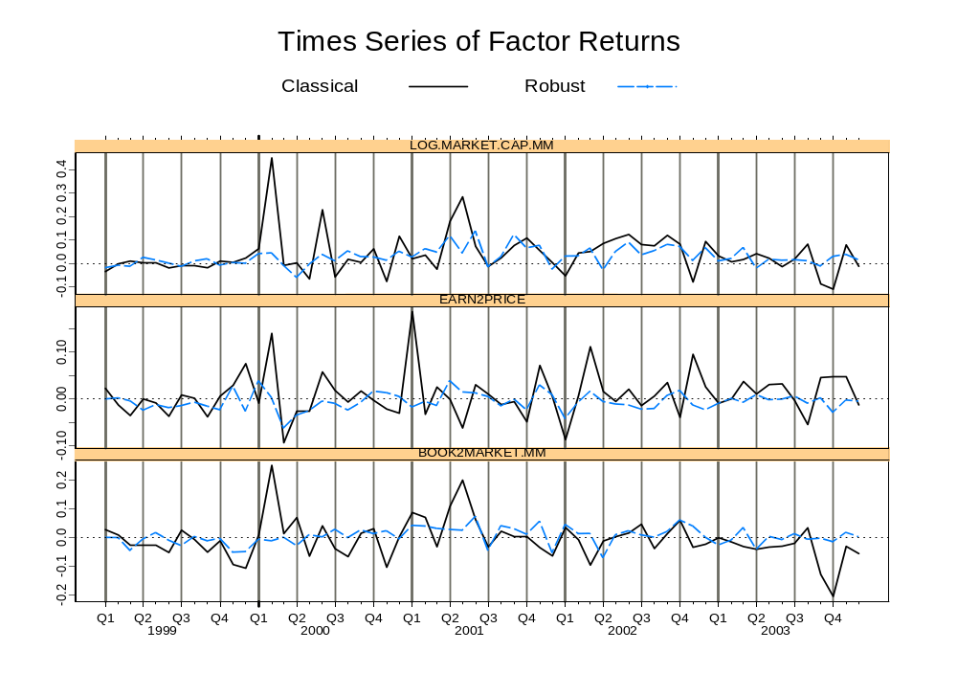
Robust versus Classical Factor Returns
Three risk factors: size, E/P, B/M, monthly returns

Slide 18
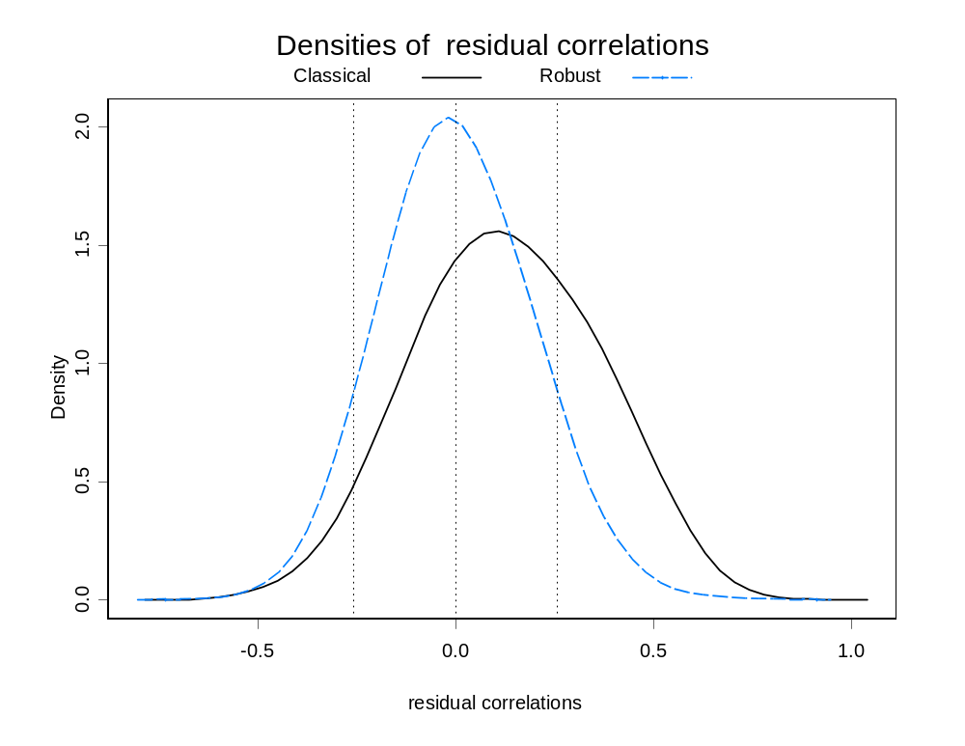
Residuals Cross-Section Correlations

Slide 19
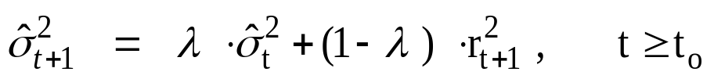
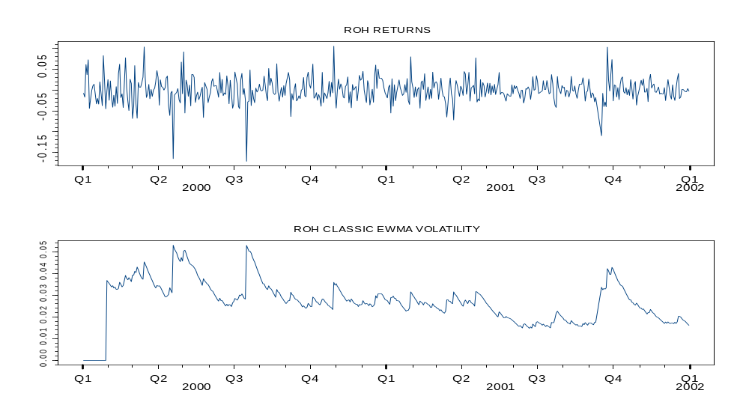
4. ROBUST VOLATILITY ESTIMATES
Classic EWMA:
Over-estimates volatilities after outlier returns!

Slide 20
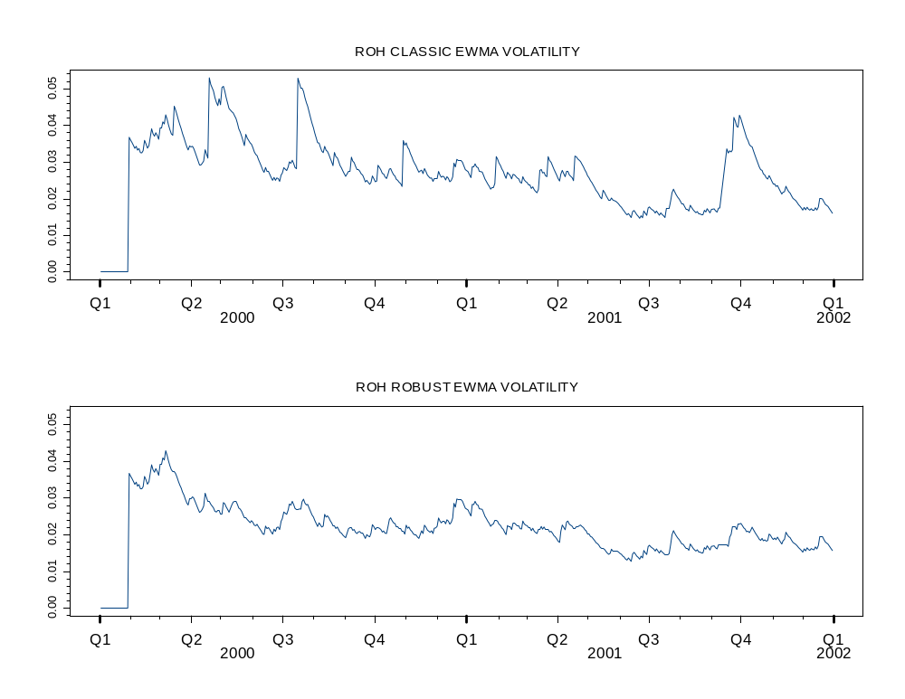
Robust EWMA Volatility Estimates

Slide 21
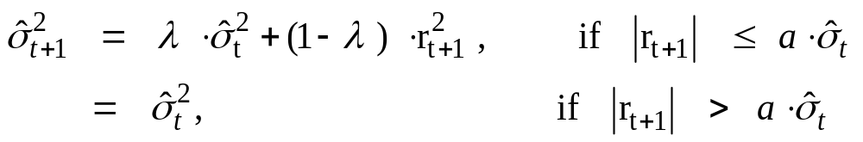
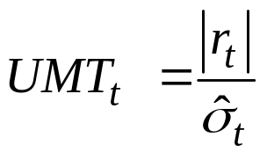
Robust EWMA
Unusual Movement Test Statistic

Slide 22
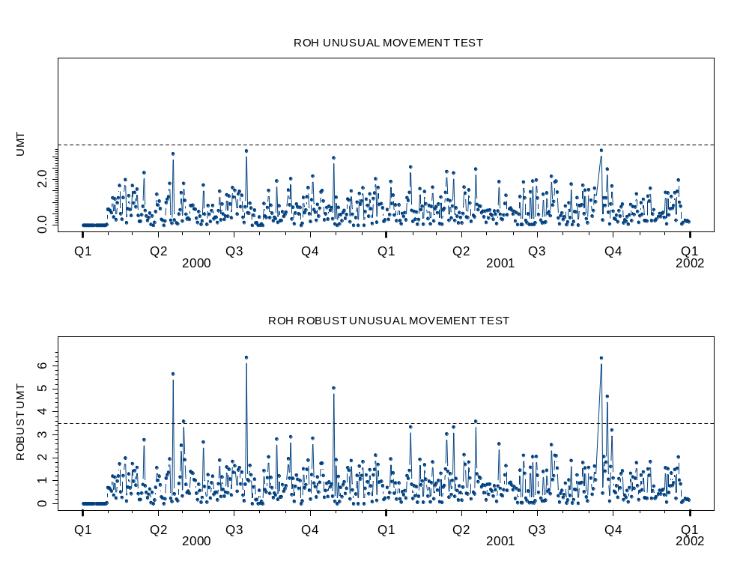

Slide 23
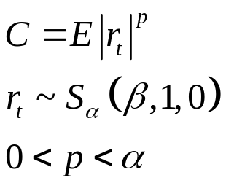
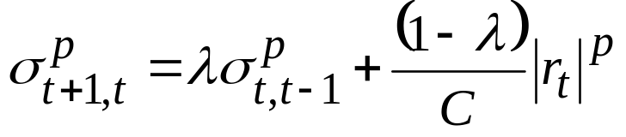
Robust EWMA and GARCH References
Robust EWMA
  Scherer and Martin (2005), Section 6.4.2
Stable Distribution EWMA
  Stoyanov (2005)
Robust GARCH
  Franses, van Djik and Lucas (1998)
  Gregory and Reeves (2001)
  Park (2002)
  Muler and Yohai (2006)
  Boudt and Croux (2006)

Slide 24
5. ROBUST COVARIANCES
Uses in Portfolio Management
  Exploring asset returns correlations
  Detecting multi-dimensional outliers
  Robust mean-variance portfolio optimization
Types of Estimates
  M-estimates (Maronna, 1976)
  Min. covariance det. (MCD) (Rousseeuw, 197x)
  Pairwise estimates (Maronna & Zamar, 197x)

Slide 25
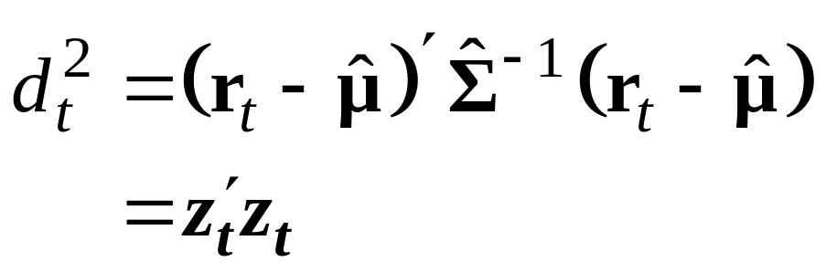
Robust Distances
So-called Mahalanobis distance
Euclidean distance in new
“spherized” coordinate system.
Classical version uses classical sample mean and sample covariance estimates. Replace them with highly robust versions, e.g., sample median and Fast Minimum Covariance Determinant (MCD) estimate.

Slide 26
Fundamental Factors Multi-D Outliers
Martin, R. D., Clark, A and Green, C. G. (2010).
Fundamental factor model context
4-D example: Size, B/M, E/P, Momentum
Monthly data 1995-2006
1,046 equities

Slide 27
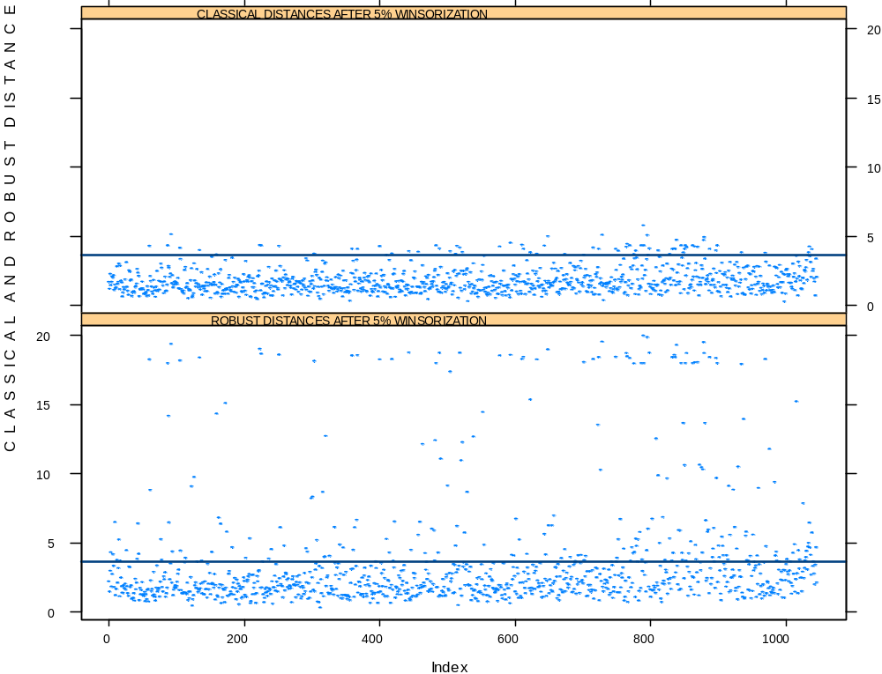
Robust vs Classical Outlier Detection
Month ending 7/31/2002

Slide 28
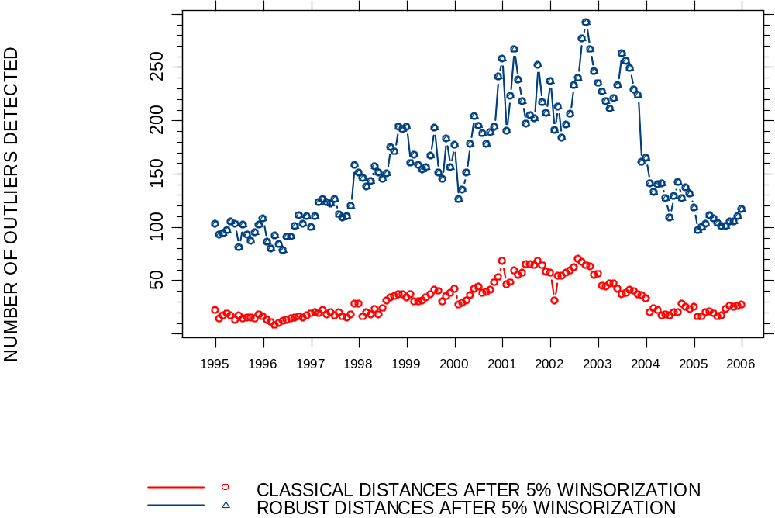
Number of 4-D Outliers Detected

Slide 29
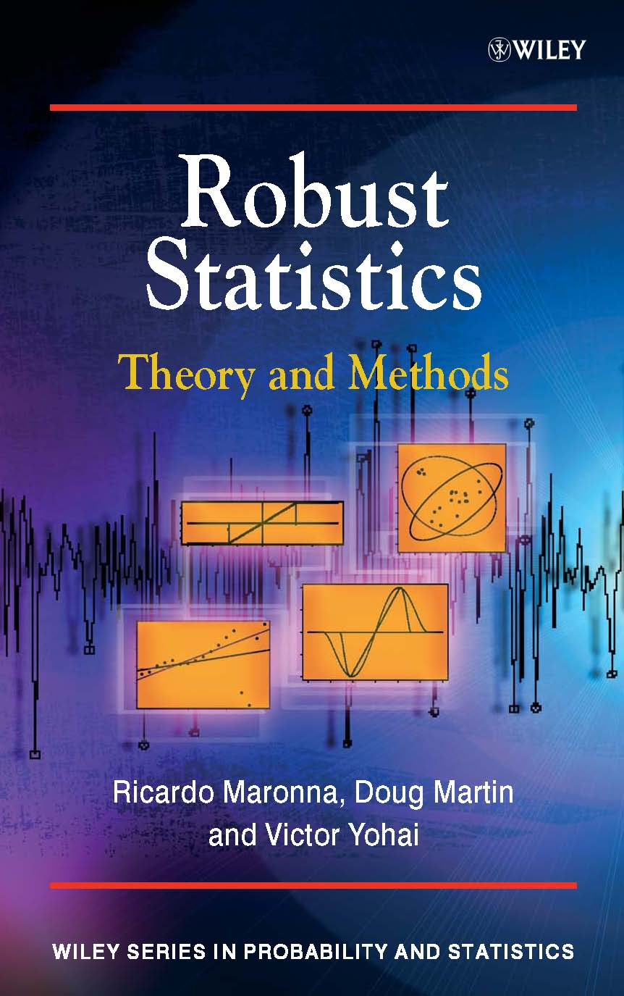
Appendix. Robustness Concepts
& Theory
Efficiency Robustness
Bias Robustness
Other Concepts
  Min-max robustness
  Continuity
  Bounded influence
  Breakdown point

Slide 30
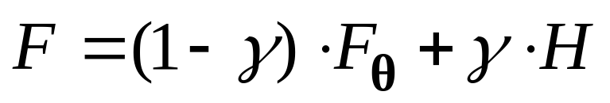

Standard Outlier Generating Model
Nominal parametric distribution
Unknown asymmetric, or
non-elliptical distributions
Unknown, often “smallish” (.01 to .02-.05) but want need protection for “large” values up to .5.
Robustness: Doing well near a parametric model.
In most applications is a normal distribution.

Slide 31
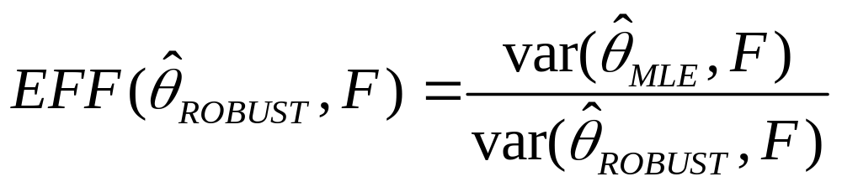
Efficiency Robustness*
High efficiency when the data distribution F is normal and also when F is “nearly normal” with fat tails, where
NOTE: Tukey favored an empirical “tri-efficiency” metric with one distribution normal, one mildly fat-tailed (normal mixture) and one very fat-tailed (Cauchy tails), and sometimes use “best known” estimate in place of MLE.
* Tukey (1960). “A Survey of Sampling from Contaminated Distributions”

Slide 32
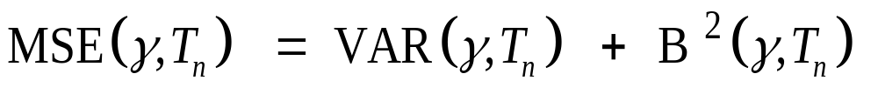


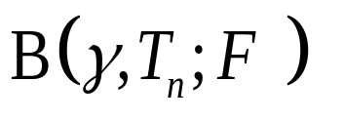
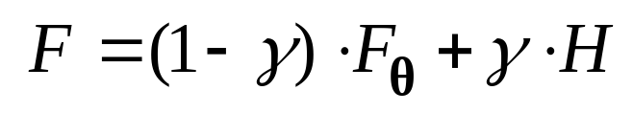
Bias Robustness
Want close to smallest attainable MSE
Since
Choose to:
minimize
for

Slide 33
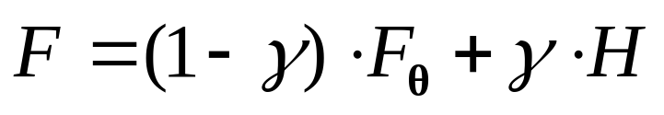
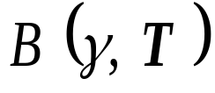

Maximum Bias Curves
Maximum bias of T over all H in
May be
asymmetric
All classical
estimates
T₁
T₂
“Breakdown”
points
GES: influence function maximum
T₃
BP₁
BP₂= .5

Slide 34


Min-Max Bias Robust Estimates
Location estimation (Huber, 1964)
  Sample median (“Leads to uneventful theory”)
Scale estimation (Martin and Zamar, 1989, 1991)
  For nominal exponential model: adjusted median
  Median absolute deviation about the median (MADM)*
  Shortest half of the data (SHORTH)*
Regression estimation: (Martin, Yohai & Zamar, 1989) and many other, including Maronna, Martin & Yohai (2006)
* Approximately for all fractions of outliers, exact as

Slide 35
References
Maronna, R. Martin, R.D., and Yohai, V. J. (2006). Robust Statistics : Theory and Methods, Wiley.
Martin, R. D., Clark, A and Green, C. G. (2010). “Robust Portfolio Construction”, in Handbook of Portfolio Construction: Contemporary Applications of Markowitz Techniques, J. B. Guerard, Jr., ed., Springer.
Bailer, H., Maravina, T. and Martin, R. D. (2012). “Robust Betas for Asset Managers”, in The Oxford Handbook of Quantitative Asset Management, Scherer, B. and Winston, K., editors, Oxford University Press.
Chapter 6 of Scherer, B. and Martin, R. D. (2004). Modern Portfolio Construction, Springer

